Slide 1

Reporting and Analyzing Merchandising Activities
4
Chapter
UAA – ACCT 201 Principles of Financial Accounting Dr. Fred Barbee

Slide 2
Periodic Inventory Method
When Inventory is Purchased
Accts. Payable
Pur. Disc.
xxx
xxx
Purchases
Contra
xxx
Pur. R&A
Inventory
xxx
BI xxx
Contra
The Inventory Account is not updated when inventory is purchased.

Slide 3
Perpetual Inventory Method
Accts. Pay
Pur. Disc.
xxx
xxx
Purchases
When Purchased
xxx
Pur. R&A
Inventory
xxx
xxx
COGS
xxx
xxx
When Sold

Slide 4
Perpetual Inventory Method
When Sale is made
Accts. Rec.
Sales Disc.
xxx
xxx
Sales
Contra
xxx
Sales R&A
Inventory
xxx
COGS
xxx
Contra
xxx
Match COGS

Slide 5
Additional Merchandising Issues

Slide 6

Adjusting Entries
Prepaid Expenses
Depreciation
Unearned Revenue
Accrued Expenses
Accrued Revenue-
There’s more!

Slide 7
Perpetual Systems – Inventory Shrinkage
Shrinkage is defined as “the loss of inventory.”
Usually charged to cost of goods sold.

Slide 8
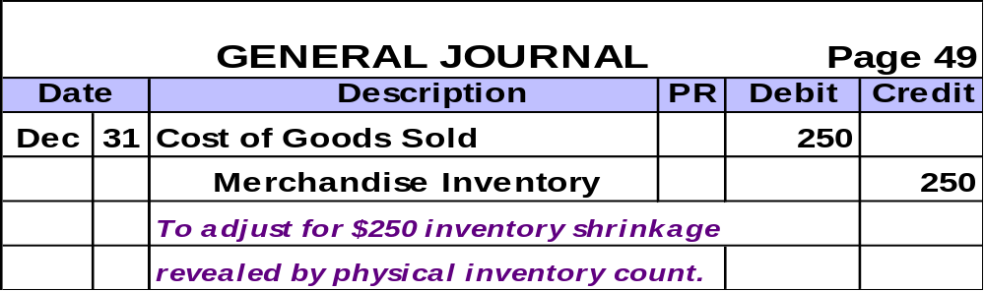
Inventory Shrinkage – Text Example
Suppose that Z-Mart’s Inventory account at year-end 2002 has a balance of $21,250, but that a physical count reveals only $21,000 of inventory on hand.

Slide 9
Closing Entries
Close the Revenue Accounts
Close the Expense Accounts
Close the Income Summary
Close the Dividends Account
There’s more!

Slide 10
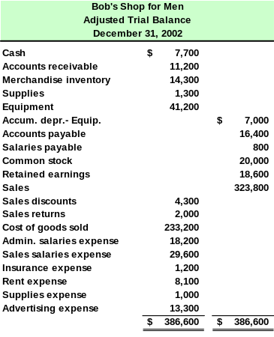
We have some new accounts
Close these with the expense accounts.

Slide 11
Let’s prepare the
closing entries for
Bob’s Shop for Men.

Slide 12
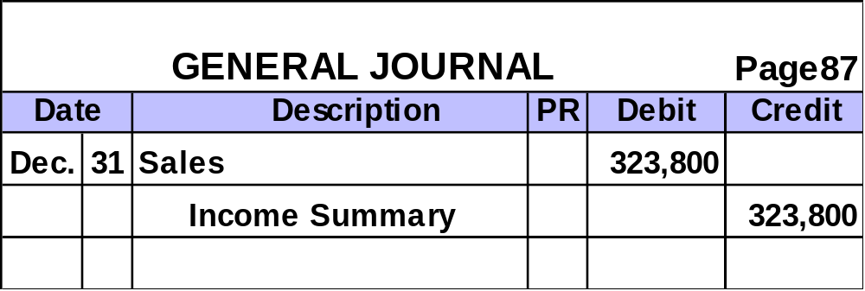

Step 1: Close the Revenue Accounts to Income Summary.

Slide 13
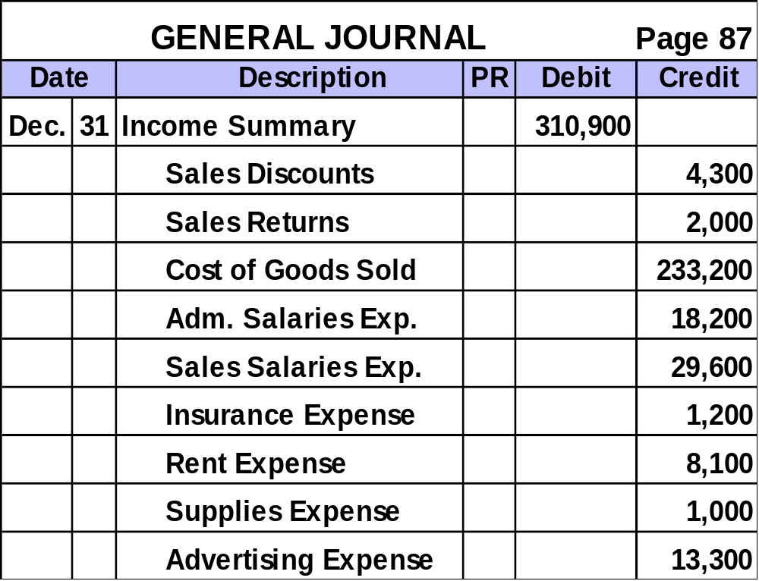
Step 2: Close the Expense Accounts to Income Summary.

Slide 14

Step 2: Close Debit Balances in Temporary Accounts to Income Summary.

Slide 15
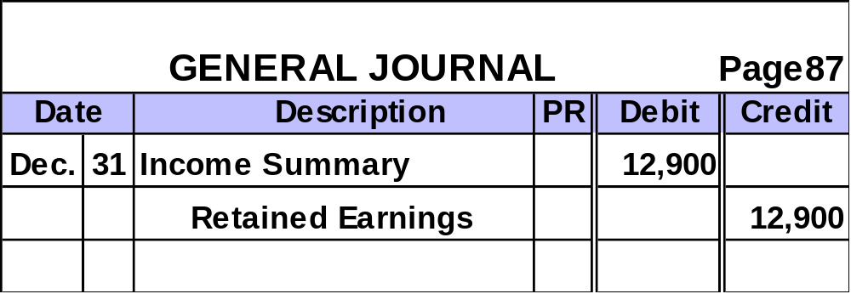

Step 3: Close Income Summary to Retained Earnings

Slide 16
Inventory Systems
Beginning
inventory
+
Net cost of
purchases
ACCT 201 ACCT 201 ACCT 201
Merchandise
available for sale
Ending Inventory
+
Cost of Goods
Sold

Slide 17
Merchandising Cost Accounts
Beginning
inventory
Year 1
Net cost of
purchases
+
Merchandise
available for sale
=
Ending Inv.
Year 1
+
Cost of Goods
Sold
Income Statement
Becomes beginning
inventory of Year 2
Balance
Sheet

Slide 18

Income Statement Formats
Multiple-Step
Single-Step

Slide 19
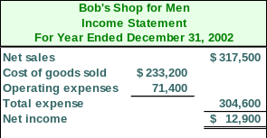
Single-Step Income Statement

Slide 20
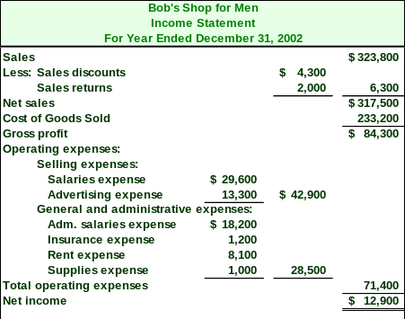
Multiple-Step Income Statement
ACCT 201 ACCT 201 ACCT 201

Slide 21
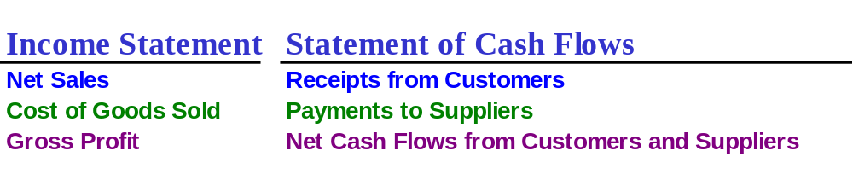
Merchandising Cash Flows
Accrual-Based
Cash-Based
Exhibit 4-19

Slide 22
Acid-Test Ratio
Acid-Test
Ratio
Quick Assets
Current Liabilities
=
Acid-Test
Ratio
Cash + S-T Investments + Receivables
Current Liabilities
ACCT 201 ACCT 201 ACCT 201
=
A common rule of thumb is the acid-test ratio should have a value of at least 1.0 to conclude a company is unlikely to face liquidity problems in the near future.

Slide 23
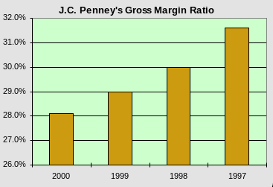
Gross Margin Ratio
Gross Margin Ratio | = | Net Sales – Cost of Goods Sold
 |  | Net Sales
Percentage of dollar sales available to cover expenses and provide a profit.

